Slide 1


SAP UI5 & FIORI with OData TRAINING
Anubhav Oberoy
Day – 8

Slide 2

Agenda – Day 8
Understanding the Component.js
Creating Component JS
Working with Multiple Views
Navigation between views
Introduction to manifest.json
Understanding the structure of manifest.json

Slide 3
Structure of a Fiori project
There are different folders and directory are required for setup project: webapp, Controller, models, utils ,view, Component.js, manifest.json, index.html
Structure of normal ui5 application
Index.html
View
Controller
Structure of Fiori Application
Dev.
sap/ui/core/UIComponent
Index.html
Root View
App.view.xml
Component.js
View 1
Controller 1
Container
App (pages)
View 2
Controller 2
manifest.json
App descriptor
App.controller.js
BaseController
Component.js is starting point

Slide 4
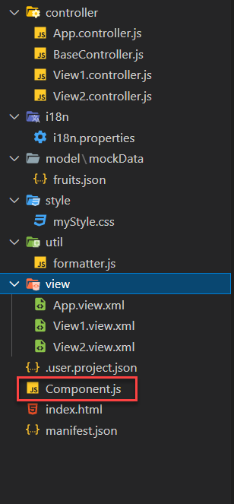
What is Component.js
Component.js the starting point of ANY Fiori app. If an app has Component.js inside, it called Fiori like app.
The Component.js file is the component controller and provides the runtime metadata and the component methods.
It is the wrapper of all the functionality. We never start any productive code in index.html, rather its all kept in Component.js
It is a class which inherits from sap/ui/core/UIComponent standard class. We inherit to reuse the functionality offered by SAP like routing.
When app starts, UI5 framework will scan your project’s base directory to check if it has a file with exact name Component.js
The component file calls the manifest file, and we keep all app level configuration inside the manifest file.
It is also important from the point of view that we will instantiate all models for our application inside the manifest file. The model instantiated in manifest file are directly set on the component and not on the root view.

Slide 5
Skeleton of Component.js
The Component.js is consists of 4 sections
metadata
init()
destroy()
createContent()
The metadata section. It has property key manifest and value json. This property calls the manifest.json file which is also know as the app descriptor file. It holds all app level configuration and helps keep our Component file clean thereby clearly separating application coding from configuration settings.
Another section of component file is the init function that is called when the component is initialized. When the component is instantiated, the init function is automatically invoked.
sap.ui.define([
'sap/ui/core/UIComponent'
], function(UIComponent) {
'use strict';
return UIComponent.extend("anubhav.app.Component",{
metadata: {},
init: function(){
},
createContent: function(){
},
destroy: function(){
}
});
});

Slide 6

Exercise: First Fiori App
In this exercise we will create a new project folder, in that folder we will add new ui5 project with an App view and a View1, and we will add a Component folder in the webapp folder.
Exercise code/resource:
firstfioriapp
webapp
controller
App.controller.js
BaseController.js
View1.controller.js
view
App.view.xml
View1.view.xml
Component.js
index.html
manifest.json

Slide 7
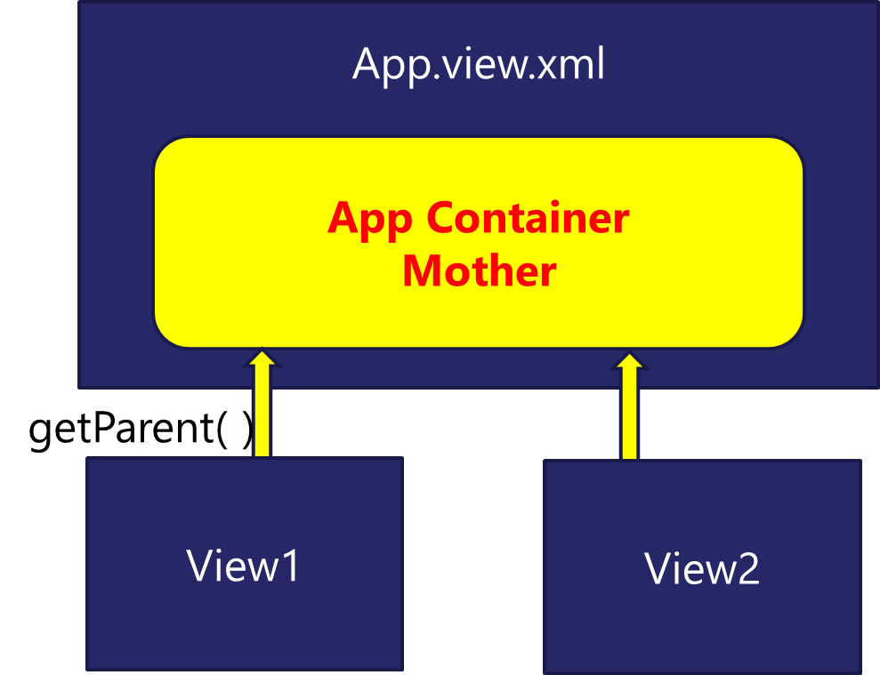
Working with multiple views in Fiori
Most of the Fiori app developed in the industry used to have more than one view. To work with multiple views, we use the concept of Parent View in the Fiori application. Which means all the views are loaded in one Parent View(App View) which then calls the view we want to display to the user.

Slide 8

Exercise: Working with multiple View
In this exercise we will add a New view in our existing application and will add button to our View1 to navigate to the View2.
Exercise code/resource:-
View1.view.xml
View1.controller.js
View2.view.xml
View2.controller.js
Component.js

Slide 9
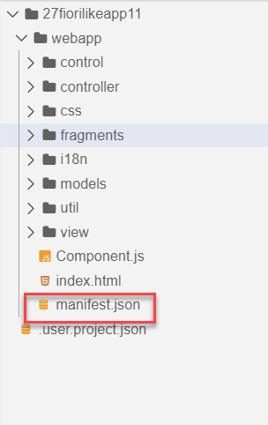
Concept of manifest.json in UI5
manifest.json is also knows as application descriptor file. It contains all the configuration for our app centrally.
Some attributes in the descriptor are just for information purposes, such as the minimum OpenUI5 version (minUI5version), others help external components (for example the SAP Fiori launchpad (FLP)) to integrate the application correctly, but most of the attributes are actually used to configure specific aspects of the app that are needed frequently.
It is written in JavaScript Object Notation (JSON) format.
We recommend that you use the manifest.json file to configure the app settings and put
all important information needed to run the app in there. Using this approach means
you need to write less application code, and you can already access the information
before the app is instantiated.
Everything which is needed for an app to start, load, move, run, configure,
requires is inside manifest.json.

Slide 10
Three Sections of manifest.json
sap.ui5 contains different components
rootView, dependencies, contentDensities, models, routing etc.
sap.ui5
sap.app contains idtype, i18n, applicationVersion, title, description, dataSources.
sap.app
sap.ui contains technology, icons, deviceTypes, supportedThemes
sap.ui

Slide 11

End of Day 8

Slide 12

Questions

Slide 13

Anubhav Oberoy

Slide 14


We’re committed to empower you to be
Most Desirable Resource
through powerful training solutions.
We build the workforce of the future.
250+
Corporate Clients
30,000+
Learners Trained
25000+
Learners Placed
FREE WEBINARS
Sign up for free webinars with industry experts every fortnight!
Enroll Now!
Contact us today!
https://anubhavtrainings.com/

Slide 15




More from AnubhavTrainings.com

Slide 16
Title
Content

